Slide 1
Welcome to Marketing Management
Dr. Cecilia Ruvalcaba
BUSI 107 Week 8, Day 3

Slide 2


Notes:
JetBlue Told A Flight Full Of People They Could Take A Trip For Free, But There Was An Important Catch
http://aplus.com/a/JetBlue-social-experiment-free-trip?c=8693&utm_campaign=i2984&utm_source=a93394&utm_content=inf_10_459_2&tse_id=INF_d4386287d0e140488ee95fbdc4b32c80

Slide 3
New Products

Slide 4
The Evolution of Ideas
IDEA GENERATION
Development of viable new product ideas.
CONCEPT TESTING
Testing the new product idea among a set of potential customers.
PRODUCT DEVELOPMENT
Development of prototypes and/or the product.
MARKET TESTING
Testing the actual products in a few test markets.
PRODUCT LAUNCH
Full-scale commercialization of the product.
EVALUATION OF RESULTS
Analysis of the performance of the new product and making appropriate modifications.
Notes:
Product Development: Google Glass: http://www.youtube.com/watch?v=9c6W4CCU9M4
Market Testing: (http://www.youtube.com/watch?v=pcj7QT0Abk8 ) is a funny commercial for Dodge where they are getting input from customers

Slide 5
Product Adoption: Diffusion of Innovations
Innovation: an idea, practice, or object that is perceived as new

Slide 6
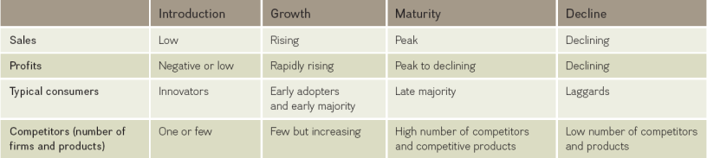
Diffusion and the Product Life Cycle (PLC)

Slide 7
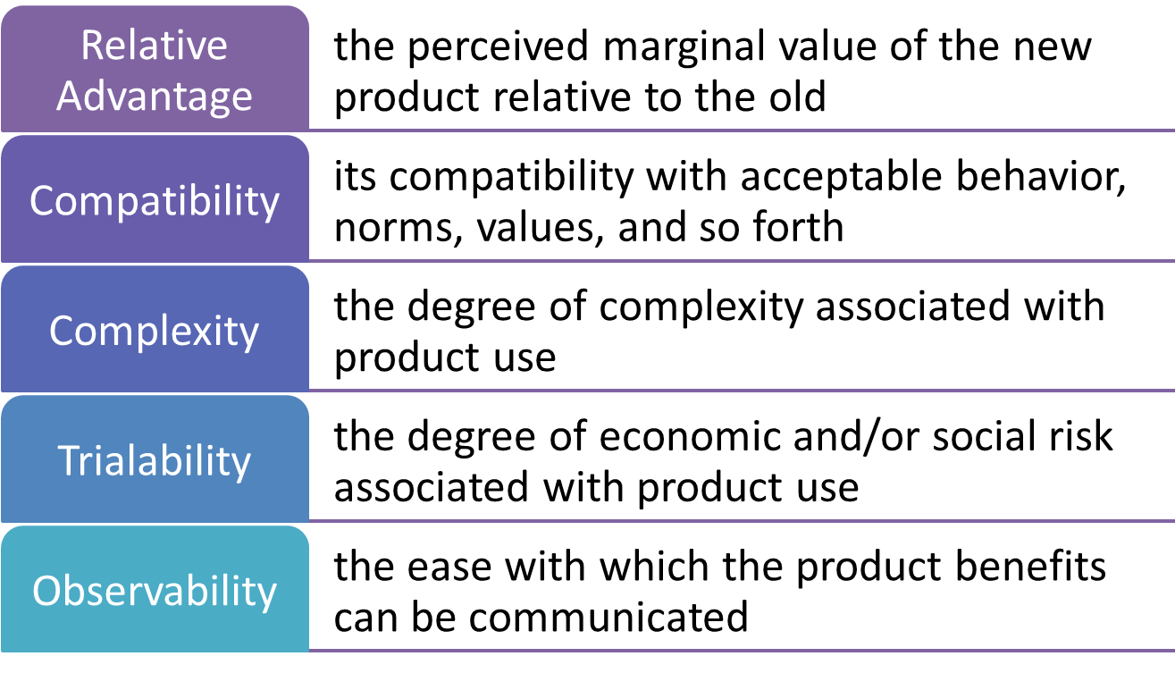
Five Characteristics of an Innovation

Slide 8
Chapter 13: Services: The Intangible product

Slide 9

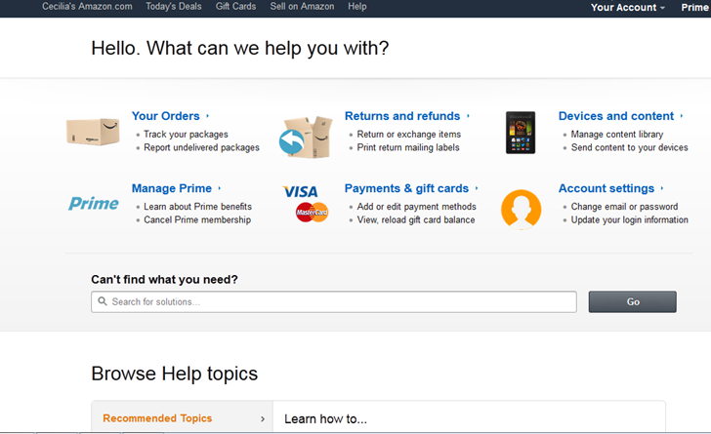
Why Services?

Slide 10




Characteristics of Services
Intangible
Requires using cues to aid customers
Atmosphere is important to convey value
Images are used to convey benefit of value
Inseparable
Production and consumption are simultaneous
Little opportunity to test a service before use
Lower risk by offering guarantees or warranties
Heterogeneous
Variability in service quality
Inferior service can’t be recalled!
Perishable
Cannot be stored for future use

Slide 11


Knowledge Gap: Understanding Customer Expectations
Marketing research: understanding customers
Evaluating service quality
Understanding customer expectations
versus

Slide 12
Evaluating Service Quality
EMPATHY
TANGIBLES
RESPONSIVENESS
ASSURANCE
RELIABILITY
The ability to perform the service dependably and accurately.
The willingness to help customers and provide prompt service.
The knowledge of and courtesy by employees and their ability to convey trust and confidence
The caring, individualized attention provided to customers.
The appearance of physical facilities, equipment, personnel, and communication materials.

Slide 13

The Standards Gap: Setting service Standards
Setting standards for quality
Developing systems to ensure high-quality service

Slide 14
The delivery gap: delivering service quality
Reduce delivery gaps
Empowering employees
Provide support & incentives
Use of technology

Slide 15

The communications gap: communicating the service promise
Manage customer expectations
Promise only what you can deliver
Communicate service expectations

Slide 16
Service Recovery
Increase Service Recovery
Listen to the customer
Resolve problems quickly
Provide a fair solution

Slide 17

Take Away for Today
Diffusion of Innovations
Who is in your market? Know who will spread the word!
Understand the characteristics of your innovation
What do customers value?
The Product Life Cycle
Providing guidance at each step
Service- the invisible product
Fill in the Gaps
Evaluate each point of in the process to find opportunities for improvement
Recover Quickly!
The sooner you recover, the better the experience and your chances of keeping that customer!

Slide 18

Next Class
Chapter 14 & 15: Price
Exam 2 (Chapters 4, 11-15) Friday 3/25

